Slide 1

Automotive Technology: A Systems Approach, 8e
Chapter 32: Intake and Exhaust Systems
Rob Thompson and Jack Erjavec, Automotive Technology: A Systems Approach, 8th Edition. © 2025 Cengage. All Rights Reserved. May not be scanned, copied or duplicated, or posted to a publicly accessible website, in whole or in part.

Slide 2
Chapter Objectives (1 of 2)
32.01 Explain the source of engine vacuum and perform engine vacuum tests.
32.02 Explain the operation of the components in the air induction system, including ductwork, air cleaner/filters, and intake manifolds.
32.03 Inspect and troubleshoot vacuum and air induction systems.
32.04 Explain the purpose and operation of forced induction components.

Slide 3
Chapter Objectives (2 of 2)
32.05 Inspect a turbocharger and describe some common turbocharger problems.
32.06 Explain supercharger operation and identify common supercharger problems.
32.07 Explain the operation of exhaust system components, including the exhaust manifold, gaskets, exhaust pipe and seal, catalytic converter, muffler, resonator, tailpipe, clamps, brackets, and hangers.
32.08 Properly perform an exhaust system inspection, and service and replace exhaust system components.

Slide 4
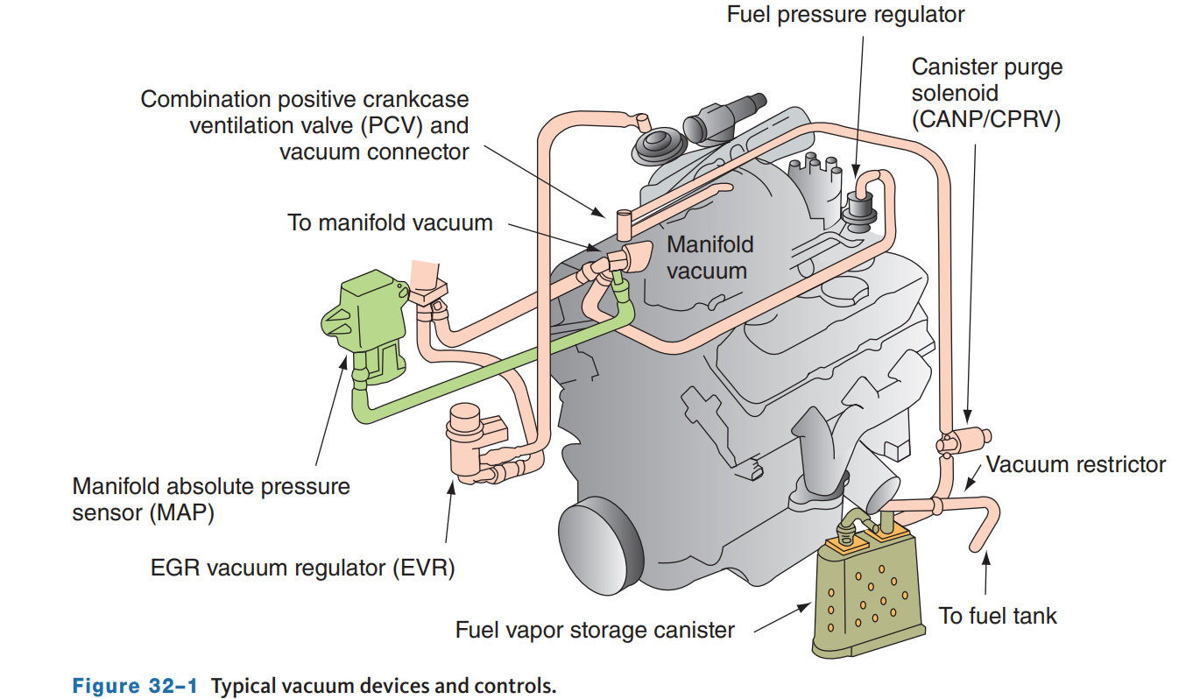
Vacuum Systems
32.01 Explain the source of engine vacuum and perform engine vacuum tests.
The vacuum in the intake manifold is created by the pistons pumping air against a restriction (throttle plate).
The vacuum draws the air into the cylinders and is used to operate or control many systems, such as emission controls, power brake boosters, parking brake releases, ventilation system components, and cruise control on older vehicles.
Vacuum is applied to these systems through a network of hoses, tubes, and control valves.

Slide 5
Vacuum Basics
Vacuum is measured in relation to atmospheric pressure.
At sea level, atmospheric pressure is 14.7 psi and is zero on most pressure gauges.
This does not mean that there is no pressure; rather, it means the gauge is designed to read pressures greater than atmospheric pressure.
Measurements taken on this type of gauge are given in pounds per square inch and should be referred to as psig (pounds per square inch gauge).
Some gauges read in bar, kP, or inches of mercury.
Gauges and other measuring devices that include atmospheric pressure in their readings also display their measurements in psi.
However, the measurements on these gauges should be referred to as psia (pounds per square inch absolute).
There is a big difference between 12 psia and 12 psig—12 psia is less than atmospheric pressure and therefore would represent a vacuum, whereas 12 psig would be approximately 26.7 psia.

Slide 6
Diagnosis and Troubleshooting
32.03 Inspect and troubleshoot vacuum and air induction systems.
Vacuum problems can produce or contribute to the following driveability symptoms:
Stalling, poor starting, backfiring, rough idle, poor acceleration, rich or lean stumble, overheating, detonation, rotten eggs exhaust odor, poor fuel economy.
Whenever there is a driveability problem, especially if lean fuel trim codes are present, here are some of the things to do:
  Inspect vacuum hoses for improper routing or disconnections.
  Look for cut or disconnected hoses that will allow more air into the intake manifold than the engine is calibrated for.
  Look for kinks in the lines and hoses that can cut off vacuum to a component, thereby disabling it.
  Check for vacuum hose routing and wear near hot spots, such as the exhaust manifold or EGR tubes.

Slide 7
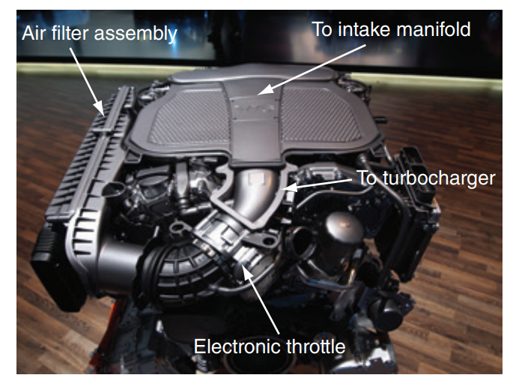
Air Induction System
32.02 Explain the operation of the components in the air induction system, including ductwork, air cleaner/ filters, and intake manifolds.
The air induction system directs outside air to the engine’s cylinders.
The induction system comprises ductwork that channels outside air to an air cleaner that removes dirt from the air, ductwork that connects the filter to the throttle body, and an intake manifold that distributes the air to the engine’s cylinders.
Within the induction system are sensors that measure intake air temperature and airflow.
An inspection of the air induction system should be part of diagnosing a driveability problem.

Slide 8
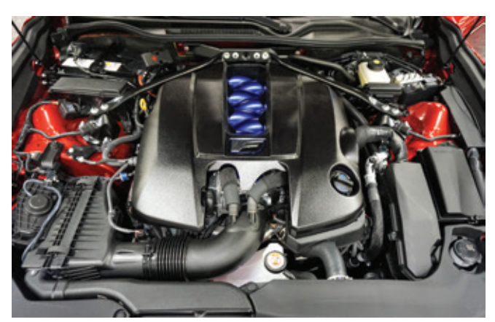
Air Cleaner/Filter
The primary purpose of the air filter is to prevent airborne contaminants and abrasives from entering the cylinders.
These contaminants can cause serious damage and appreciably shorten engine life. Therefore, all intake air should pass through the filter before entering the engine.
It is inside a sealed air cleaner assembly.
This assembly is also used to direct the airflow and reduce the noise caused by the movement of intake air.
It also provides filtered air to the PCV system and provides engine compartment fire protection.

Slide 9
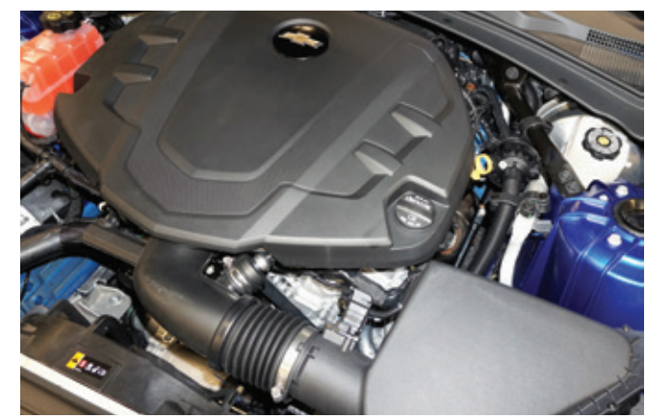
Induction Hoses
To route air into the engine, a network of induction hoses and pipes are used.
Air enters through the fresh air inlet and passes through induction hoses and pipes.
Induction hoses are typically flexible rubber hoses.
Some vehicles use rigid plastic pipes to move air that may also have a Helmholtz chamber or resonator.
The purpose of the chamber is to reduce noises generated by air moving through the induction system and intake manifold.
Some vehicles use sound enhancing systems that route hoses from the induction system to the passenger compartment.

Slide 10
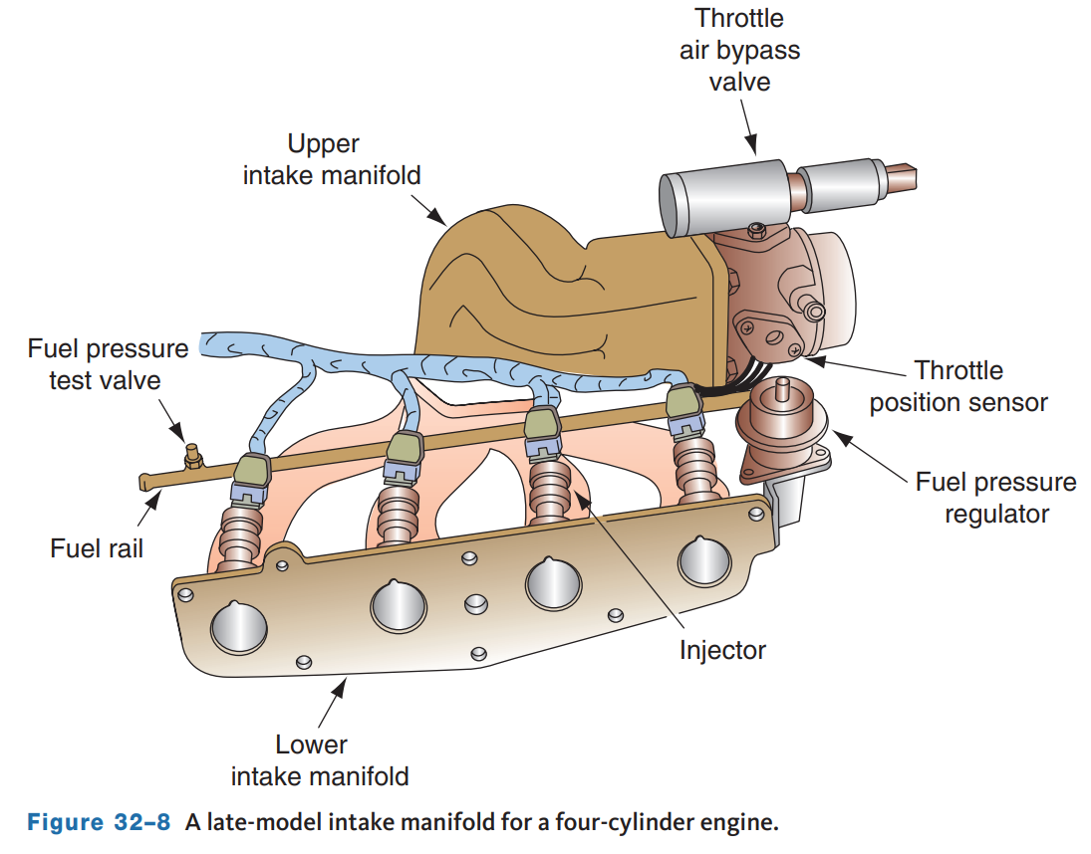
Intake Manifolds
An intake manifold distributes the clean air or air–fuel ratio as evenly as possible to each cylinder of the engine.
Intake manifolds also serve as the mounting point for many intake-related accessories (such as the fuel injectors, fuel rail, and throttle body) and sensors.
Some include a provision for mounting the thermostat and thermostat housing.
Intake manifolds for today’s engines are typically made of die-cast aluminum or more commonly, plastic.
These materials are used to reduce weight.

Slide 11
Design Variations
Basic manifold design varies with the different types of engine.
For example, the intake manifold for a four-cylinder engine has either four runners or two runners that break into four near the cylinder head.
Inline six-cylinder engines have six runners or three that branch off into six near the cylinder head.
On V-type engines, there are individual runners for each cylinder.
An intake manifold has two basic components: a plenum area and runners.
As air first enters the intake manifold, it moves into the plenum.
The air then moves from the plenum through the runners to the cylinders.
The size and shape of the plenum and runners are designed for a specific engine and application.

Slide 12
Water Injection Systems
To extract even more power and efficiency from an engine, the twin-turbocharged six-cylinder engine that powers the BMW M4 GTS is fitted with a water injection system that sprays a cooling mist into the intake air.
This reduces the temperature in the cylinder, which improves combustion and allows the engine to run at higher boost levels by reducing knocking and heat-related stresses.
A water injection ECM monitors and controls systems operation.
Once injected into the cylinders, the water quickly evaporates, lowering the temperature of incoming air.
The system lowers the air temperature more than an intercooler can (by as much as 80 °F or 26.7 °C).
Therefore, the turbos can provide higher boost levels without causing engine knocking.
Water injection decreases cylinder temperature and allows advanced ignition timing and higher compression ratios.

Slide 13
Servicing an Intake Manifold
There are few reasons why an intake manifold would need to be replaced or repaired. If the manifold is cracked or the sealing surfaces are severely damaged, it should be replaced.
When the manifold is removed or there is evidence of a leak between the manifold and the cylinder head, the sealing surfaces should be checked for flatness.
This check should include coolant and oil passages.
Minor imperfections on the surface can be filed smooth; however, never try to repair any serious damage.
A leaking manifold gasket is one of the most common causes of internal coolant leaks.
A bad gasket can also cause vacuum leaks.
When installing an intake manifold, use new gaskets and seals.
Make sure that the manifold and gasket are aligned properly.
On V-type engines, the use of guide bolts helps to ensure proper alignment.

Slide 14
Knowledge Check (1 of 2)
A vacuum leak can be caused by a leaking intake manifold _________.

Slide 15
Knowledge Check Answer (1 of 2)
  Answer: A vacuum leak can be caused by a leaking intake manifold gasket.

Slide 16
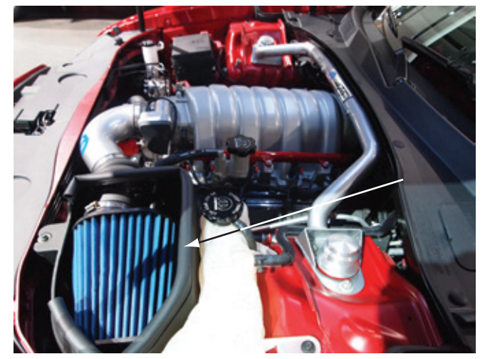
Forced Induction Systems
32.04 Explain the purpose and operation of forced induction components.
With today’s body styles, hood scoops are not particularly desired because they increase air drag. Therefore, other methods are used to increase the volume of intake air and compression.
Some manufacturers are exploring variable compression engines but none are yet in production.
Performance gains have been made through air filter designs.
The shape of the filter and its direct exposure to the air allow for increased intake flow.

Slide 17
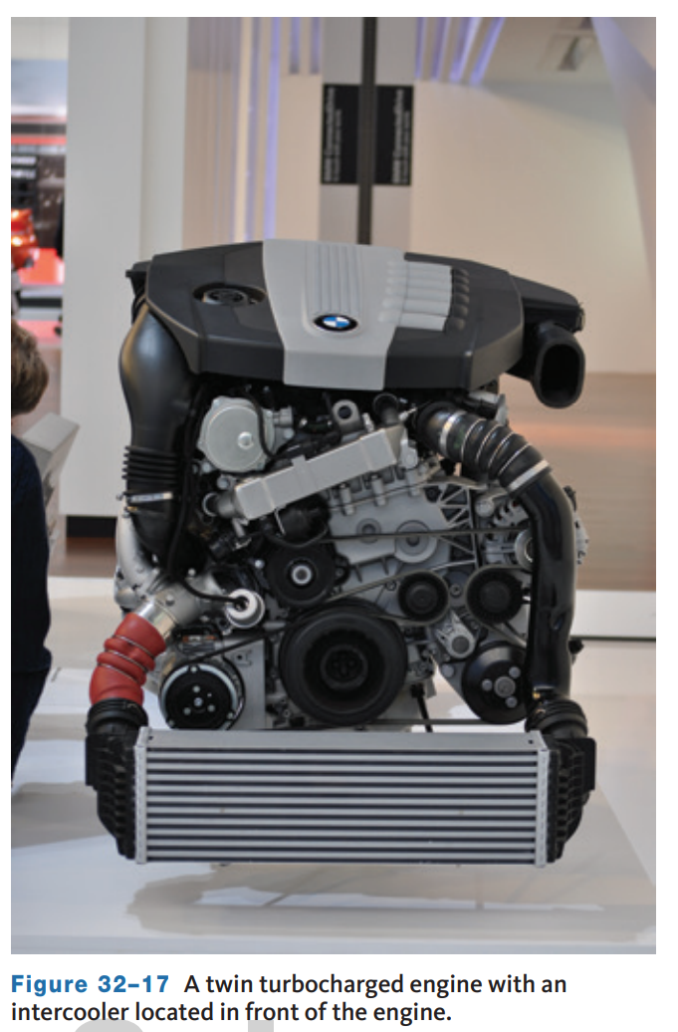
Intercoolers
The intercooler cools the turbocharged or supercharged air before it reaches the combustion chamber.
The removal of heat from the pressurized air going into the intercooler increases the density of the air, which improves efficiency, engine horsepower, and torque.
Intercoolers are actually radiators for the intake air.
The heat from the compressed air that passes through it is removed and dissipated to the atmosphere.
An intercooler system may consist of an added radiator in the grill area.

Slide 18
Turbochargers
Turbochargers are used to increase engine power by compressing intake air before it enters the engine.
Turbochargers are air pumps driven by the engine’s exhaust stream.
The heat and pressure of the exhaust gases spin the turbine blades.
The turbine wheel is connected to a compressor wheel. As the turbine spins, so does the compressor wheel.
The compressor wheel spins at very high speeds and compresses the intake air. The compressed air is then sent to the cylinders.
Because exhaust gas is a waste product, the energy developed by the turbine is said to be free because it theoretically does not use any of the engine’s power it helps to produce.
Turbochargers are used on both diesel and gasoline engines.
The main advantage of their use is that they allow for an increase of power without a substantial decrease in fuel economy.

Slide 19
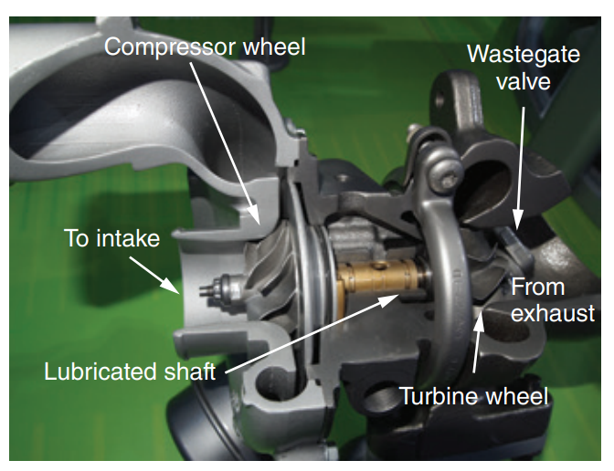
Construction
A turbocharger is normally located at or close to the exhaust manifold.
On some engines, the exhaust pipe runs between the exhaust manifold and the turbine housing to carry the exhaust flow to the turbine wheel.
On some newer engine designs, the exhaust manifold is incorporated into the cylinder head.
This can significantly increase the efficiency of driving the turbine.
A typical turbocharger, usually called a turbo, has the following components:
  Turbine wheel, Shaft, Compressor wheel, Center housing and rotating assembly (CHRA), Wastegate valve.

Slide 20
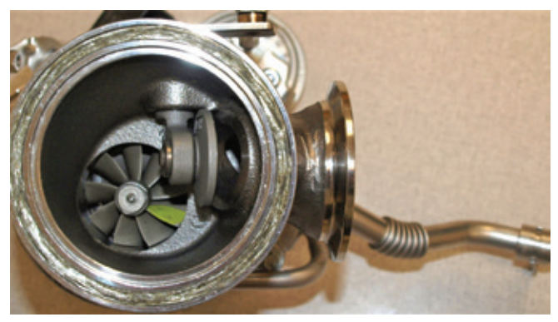
Wastegate Valve
If the pressure of the air from a turbocharger becomes too high, knocking occurs, engine output decreases, and the pressure created by the combustion of the air–fuel mixture can become so great that the engine may self-destruct.
To prevent this, turbochargers have a wastegate valve.
The wastegate valve is part of the turbine housing.
It allows a certain amount of exhaust gas to bypass the turbine when the boost pressure exceeds a certain value.
This action reduces the pressure.

Slide 21
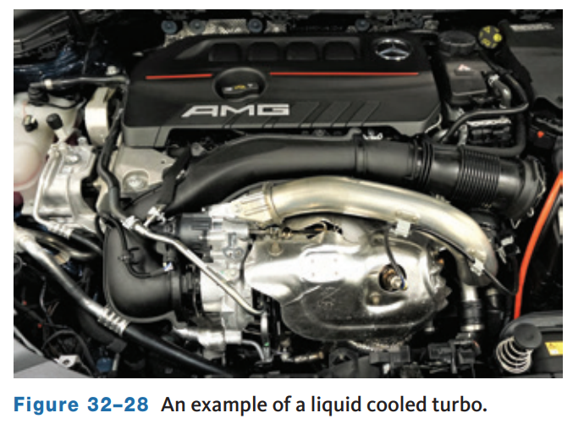
Turbo Lubrication and Cooling
The bearings are lubricated by engine oil and rotate freely on the shaft and in the housing.
Engine oil is delivered to the turbocharger through an oil inlet pipe and then circulated to the bearings.
The bearings have outer seals to prevent oil leakage. The oil passes over the bearings and returns to the engine’s oil pan through an oil outlet pipe.
The circulation of the oil cools the turbocharger.
A turbocharger may be cooled by engine coolant that circulates through coolant channels built into the housing.
Coolant is sent from the engine’s thermostat housing through a coolant inlet pipe to the turbo. housing.

Slide 22
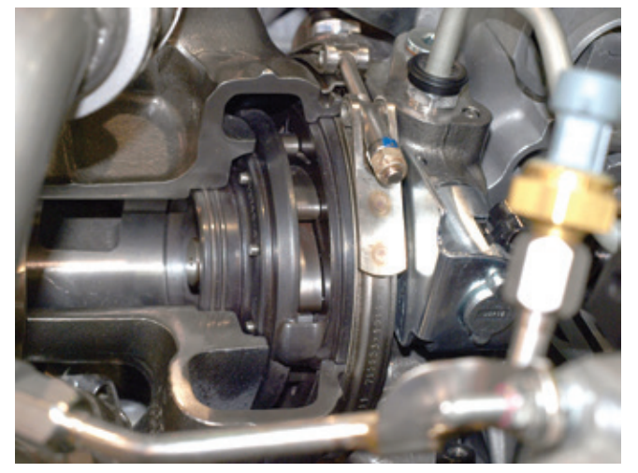
DualBoost Single Sequential Turbocharger
In 2011, Ford installed a DualBoost turbocharger on their 6.7-liter PowerStroke diesel engines.
This turbocharger has two compressor wheels and one turbine wheel.
The compressor wheels have different shapes and sizes, but they are mounted onto the same shaft.
The two compressor wheel housings are also different sizes.
This creates a sequential turbo by allowing fast spooling up of the small compressor followed by increased air volume from the larger wheel.
The volume of the single exhaust inlet housing is controlled by the vanes of the variable geometry system.

Slide 23
Turbocharger Inspection
32.05 Inspect a turbocharger and describe some common turbocharger problems.
To inspect a turbocharger, start the engine and listen to the sound that the turbo system makes.
If the turbo sound cycles or changes in intensity, the likely causes are a plugged air cleaner or loose material in the compressor inlet ducts or dirt buildup on the compressor wheel and housing.
After listening, check the air cleaner and remove the ducting from the air cleaner to turbo and look for dirt buildup or damage from foreign objects.
Check for loose clamps on the compressor outlet connections and check the engine intake system for loose bolts or leaking gaskets.
Then disconnect the exhaust pipe and look for restrictions or loose material.
Examine the exhaust system for cracks, loose nuts, or blown gaskets.
Rotate the turbo shaft assembly.
Visually inspect all hoses, gaskets, and tubing for proper fit, damage, and wear.

Slide 24
Replacing a Turbocharger
If the turbocharger is faulty, it should be replaced with a new or rebuilt unit.
Always follow the procedure given in the service information.
Before removing the turbocharger, plug the intake and exhaust ports and the oil inlet to prevent the entry of dirt or other foreign material.
While replacing it, check for an accumulation of sludge in the oil pipes and, if necessary, clean or replace the oil pipes.
Do not drop or bang the new unit against anything or grasp it by easily deformed parts. When installing a new turbocharger, put 20 cc (0.68 oz.) of oil into the turbocharger oil inlet and turn the compressor wheel by hand several times to spread oil to the bearings.
After installing the new turbocharger, or after starting an engine that has been unused, there can be a considerable lag after engine startup before the oil pressure is sufficient to deliver oil to the turbo’s bearings.

Slide 25
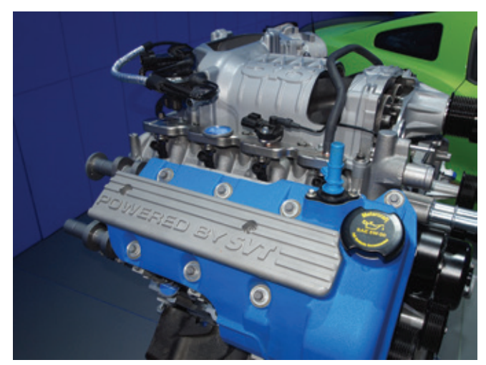
Superchargers
32.06 Explain supercharger operation and identify common supercharger problems.
Today, some engines have a supercharger as an alternative to the turbo.
Superchargers are positive displacement air pumps driven directly by the engine’s crankshaft via a V-ribbed belt.
They improve horsepower and torque by increasing air pressure and density in the intake manifold.
The pressure boost is proportional to engine speed.

Slide 26
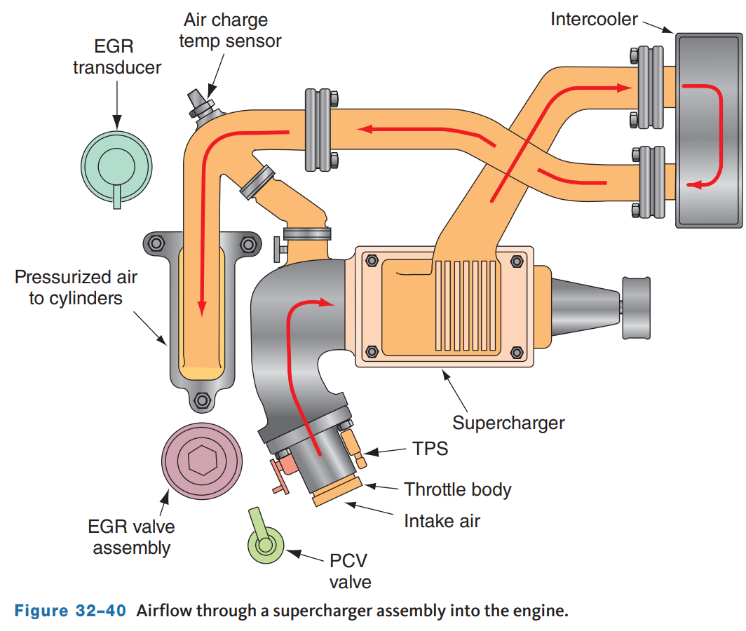
Supercharger Operation
The air comes in through the remote-mounted air cleaner and the mass airflow meter.
It then moves through the throttle plate assembly and passes through the supercharger inlet plenum assembly, which is bolted to the back of the supercharger.
The air enters the supercharger and is pressurized by the spinning rotors.
It then exits through the top of the supercharger by way of the air outlet adapter.
As the air is compressed, its temperature increases.

Slide 27
Supercharger Problems
Many of the problems and their remedies given for turbochargers hold good for superchargers.
There are also problems associated specifically with the supercharger.
Refer to the service information for the symptoms of supercharger failure and a summary of the causes and the recommended repairs.
Other than replacing the drive belt, cooling and induction hoses, supercharger service requires replacement of the unit itself.

Slide 28
Discussion
Turbochargers and superchargers have some similarities but also some substantial differences.
Have a class discussion while describing the similarities and differences. Include how they are driven, how the pressure is controlled, and similar.

Slide 29
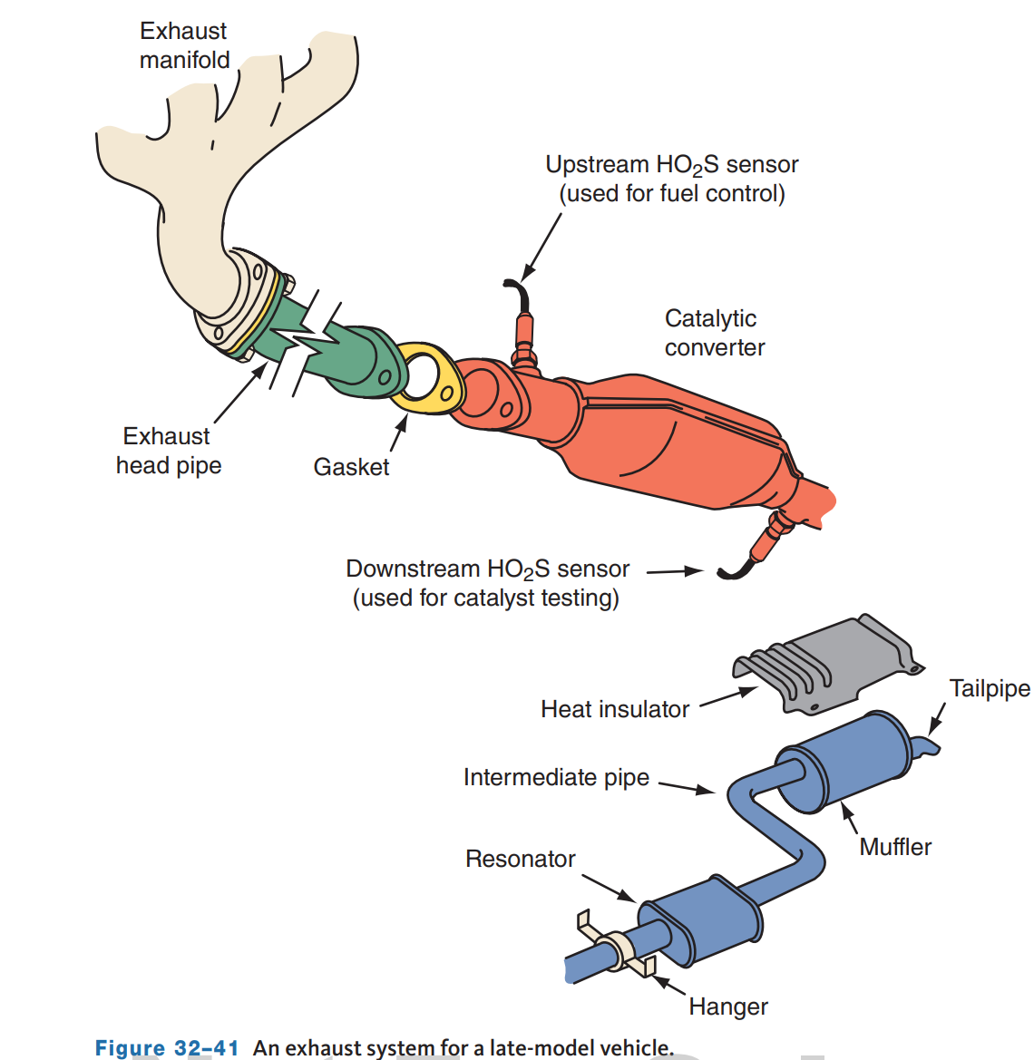
Exhaust System Components
32.07 Explain the operation of exhaust system components, including the exhaust manifold, gaskets, exhaust pipe and seal, catalytic converter, muffler, resonator, tailpipe, clamps, brackets, and hangers.
The various components of the typical exhaust system include the following:
  Exhaust manifold(s), Exhaust pipe and seal, Catalytic converter(s), Muffler(s), Resonator, Tailpipe, Heat shields, Clamps, brackets, and hangers, Exhaust gas oxygen sensors.

Slide 30
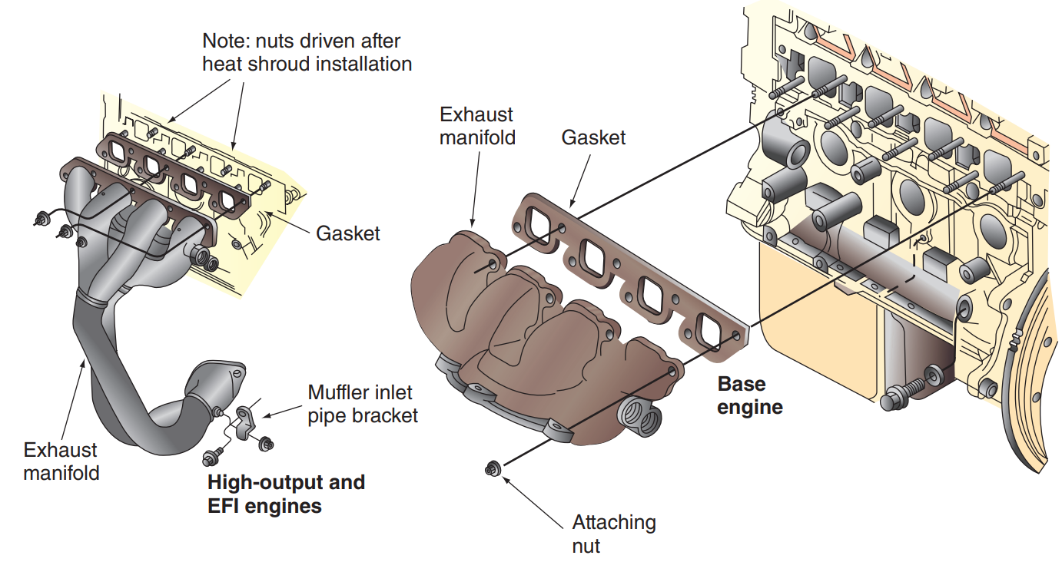
Exhaust Manifold
The exhaust manifold collects the burnt gases as they are expelled from the cylinders and directs them to the exhaust pipe.
Exhaust manifolds for most vehicles are made of cast or nodular iron.
Many newer-vehicles have stamped, heavy-gauge sheet metal or stainless steel units.
Many newer turbocharged engines incorporate the exhaust manifold into the design of the cylinder head.

Slide 31
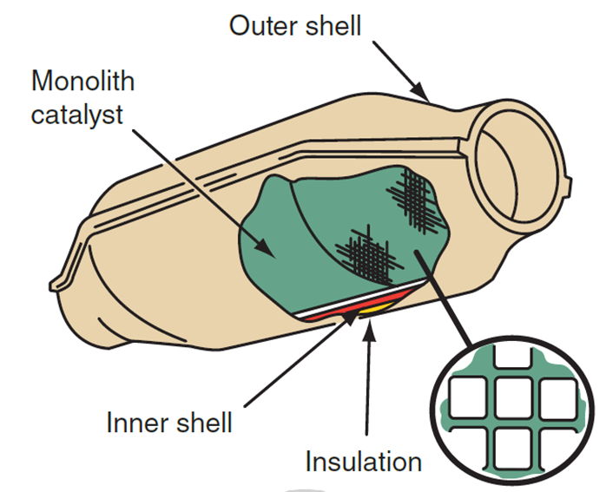
Catalytic Converters
A catalytic converter is part of the exhaust system and a very important part of the emission control system.
The catalytic converter is located ahead of the muffler in the exhaust system.
The extreme heat in the converter oxidizes the exhaust that flows out of the engine.
Because it is part of both systems, it has a role in both.
As an emission control device, it is responsible for reducing the amount of harmful exhaust emissions.
As part of the exhaust system, it helps reduce the noise level of the exhaust.

Slide 32
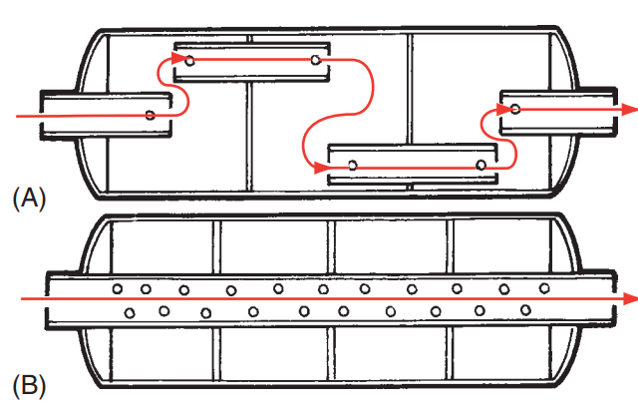
Mufflers
The muffler is a cylindrical or oval-shaped component, generally about 2 feet (0.6 meter) long, mounted in the exhaust system about midway or toward the rear of the car.
Inside the muffler is a series of baffles, chambers, tubes, and holes to break up, cancel out, or silence the pressure pulsations that occur each time an exhaust valve opens.
Two types of mufflers are frequently used on passenger vehicles.
Reverse-flow mufflers change the direction of the exhaust gas flow through the inside of the unit.

Slide 33
Exhaust System Components
Resonator
  On some vehicles, there is an additional muffler, known as a resonator or silencer. This unit is designed to further reduce or change the sound level of the exhaust and may be used with low backpressure mufflers.
  It is located toward the end of the system and generally looks like a smaller, rounder version of a muffler.
Tailpipe
  The tailpipe is the last pipe in the exhaust system. It releases the exhaust fumes into the atmosphere beyond the back end of the car.
Clamps, Brackets, and Hangers Clamps, brackets, and hangers
  They are used to properly join and support the various parts of the exhaust system.
  These parts also help to isolate exhaust noise by preventing its transfer through the frame or body to the passenger compartment.

Slide 34
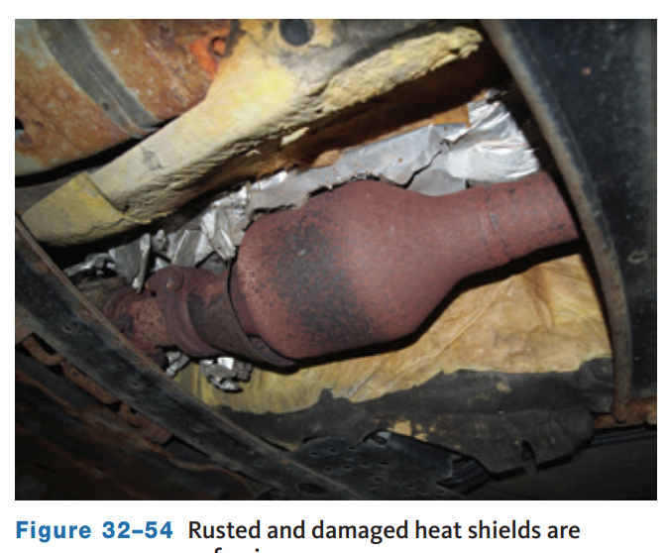
Exhaust System Inspection
32.08 Properly perform an exhaust system inspection, and service and replace exhaust system components.
Most parts of the exhaust system, particularly the exhaust pipe, muffler, and tailpipe, are subject to rust, corrosion, and cracking.
Broken or loose clamps and hangers can allow parts to separate or hit the road as the car moves.
All inspections should include listening for abnormal noises.
If rattling or knocking noises are heard, check for contact between exhaust pipes and other components, especially if a custom exhaust is installed.

Slide 35
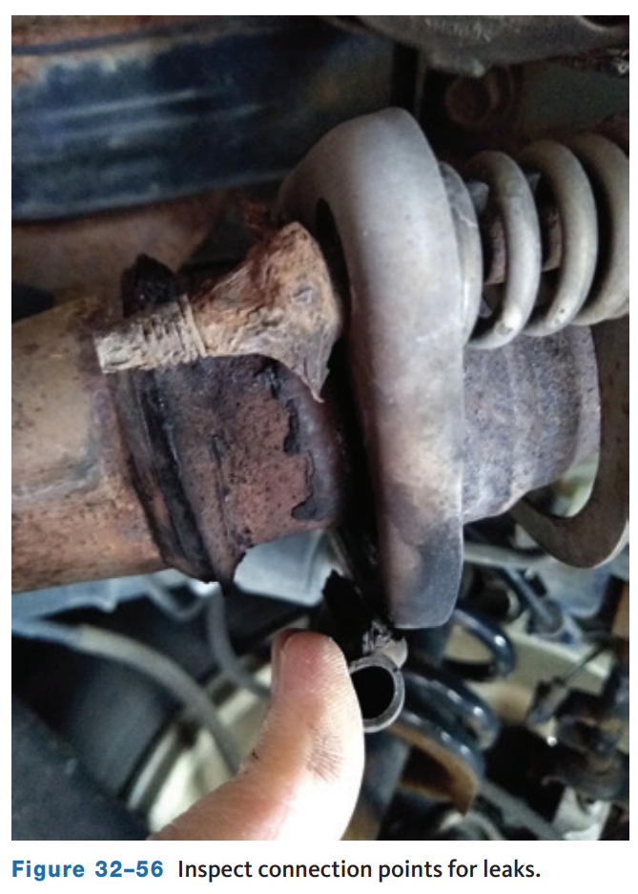
Exhaust Leaks
Exhaust leaks are often identified by sound, very small leaks can be difficult to locate.
Check along the pipes, paying close attention at connections and where hangers or brackets attach, for evidence of a leak.
Temporarily plugging the tail pipe will cause the exhaust pressure to back up, causing the leak to “hiss,” making it easier to find.
One of the most effective ways to identify the source of a leak in the system is the use of a smoke machine.
When smoke is introduced to the exhaust system, a trace of smoke will identify the source of the leak.

Slide 36
Knowledge Check (2 of 2)
Why would a technician introduce white smoke into an exhaust system?

Slide 37
Knowledge Check Answer (2 of 2)
Answer: To inspect for and locate a leak.

Slide 38
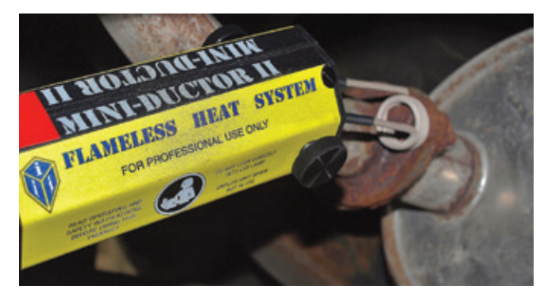
Replacing Exhaust System Components
Exhaust system component replacement might require the use of special tools and welding equipment.
If it is necessary to weld exhaust components together, disconnect the battery negative cable to prevent damage to electronic components.
A tool that often makes exhaust work easier is the induction heater.
This tool uses high-frequency magnetic fields to excite and heat ferrous metal parts quickly and safely without a flame.

Slide 39
Chapter Reflection
Please take a moment to compare your perception of the intake and exhaust systems before and after you studied this chapter. Then respond to the following questions in one or two paragraphs. Use 150–200 words in your reflection.
Did you find any of the concepts difficult to understand? How will you better your understanding of these concepts?
Considering all you have learned, do you feel you are prepared to perform intake and exhaust system service in a shop or lab setting? How will you ensure you are prepared?

